Slide 1

CIT-2180 Data and Database Management Chapter 9 (PART ONE)

Slide 2

Oracle 12C: SQL
Chapter 9 (PART ONE)
Joining Data from Multiple Tables

Slide 3
Purpose of Joins
Joins are used to link tables and reconstruct data in a relational database
Joins can be created through:
Conditions in a WHERE clause (Traditional)
Use of JOIN keywords in FROM clause (ANSI)
3

Slide 4
CROSS JOIN (also called Cartesian product)
Each row in the first table is matched with each row in the second table (can join more than two tables)
Created by omitting joining condition in the WHERE clause (traditional) or through CROSS JOIN keywords in the FROM clause (ANSI)
Results in every possible row combination (m * n)
NOTE: This is seldom used in practice
4

Slide 5
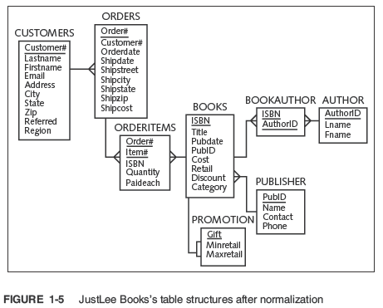

Slide 6
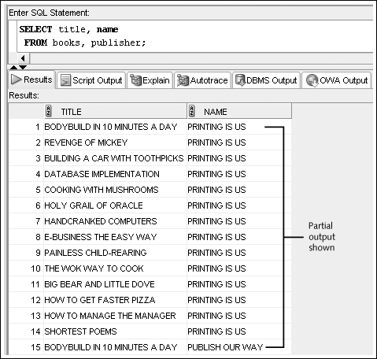
CROSS JOIN Example
6

Slide 7
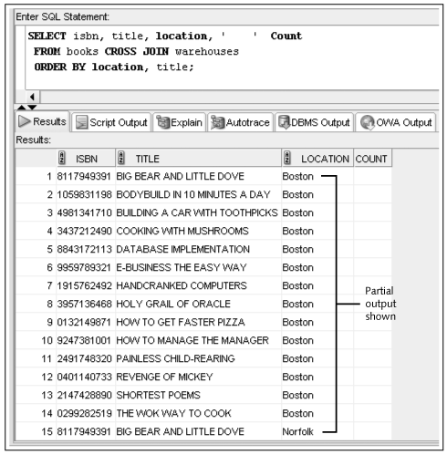
CROSS JOIN Example (ANSI)
7

Slide 8
CROSS JOIN EXAMPLE
Traditional method:
SELECT title, name
FROM books, publisher;
ANSI method:
SELECT title, name
FROM books CROSS JOIN publisher;

Slide 9
INNER (NATURAL) JOINS (also called equality join or equijoin)
Each row in the first table is matched with each row in the second table, but only through equivalent data that exists in both tables.
Created by:
Creating equivalency condition in the WHERE clause (traditional)
Using NATURAL JOIN, JOIN…USING, or JOIN…ON keywords in the FROM clause (ANSI)
9

Slide 10
Show all book titles with their publishers name.

Slide 11
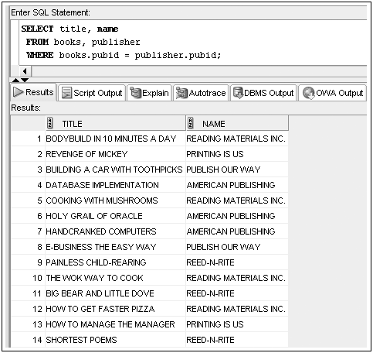
INNER (NATURAL) JOIN Example
11

Slide 12
INNER (NATURAL) JOIN EXAMPLE
Traditional method:
SELECT title, name
FROM books, publisher
WHERE books.pubid = publisher.pubid;
ANSI method:
SELECT title, name
FROM books JOIN publisher USING (pubid);

Slide 13
INNER (NATURAL) JOIN EXAMPLE 2
Traditional method:
SELECT title, name, p.pubid
FROM books b, publisher p
WHERE b.pubid = p.pubid;
ANSI method:
SELECT title, name, pubid
FROM books JOIN publisher USING (pubid);

Slide 14
Show customer last and first names and their book titles.

Slide 15
MULTI-TABLE NATURAL JOIN Example
Traditional method:
SELECT c.lastname, c.firstname, b.title
FROM customers c, orders o,
orderitems oi, books b
WHERE c.customer# = o.customer#
AND o.order# = oi.order#
AND oi.isbn = b.isbn
ORDER BY lastname, firstname;

Slide 16
MULTI-TABLE NATURAL JOIN Example
ANSI method:
SELECT lastname, firstname, title
FROM customers JOIN orders USING (customer#)
JOIN orderitems USING (order#)
JOIN books USING (isbn)
ORDER BY lastname, firstname;

Slide 17

Equality Joins: NATURAL JOIN
17

Slide 18
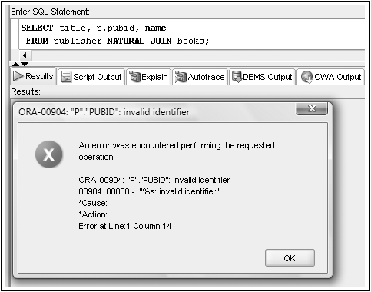
No Qualifiers with a NATURAL JOIN
18

Slide 19

Equality Joins: JOIN…USING
19

Slide 20

Equality Joins: JOIN…ON
Required if column names are different
20

Slide 21
JOIN Keyword Overview (ANSI)
Use JOIN…USING when tables have one or more columns in common
Use JOIN…ON when same named columns are not involved or a condition is needed to specify a relationship other than equivalency (next section)
Using the JOIN keyword frees the WHERE clause for exclusive use in restricting rows
21

Slide 22
Oracle 12C: SQL
END OF Chapter 9
Joining Data from Multiple Tables

